Slide 1



SIPOC
A High-Level Tool for Process Clarity and Improvement
Unlock the power of visual process mapping to drive efficiency, alignment, and continuous improvement across your organization.
Developed by Jan Larsson
Notes:
“SIPOC is a high-level process mapping tool that helps us see the big picture. It stands for Suppliers, Inputs, Process, Outputs, and Customers. By defining each of these, we clarify how work flows, who’s involved, and what value is delivered. It’s a simple way to align teams and spot opportunities for improvement.”

Slide 2
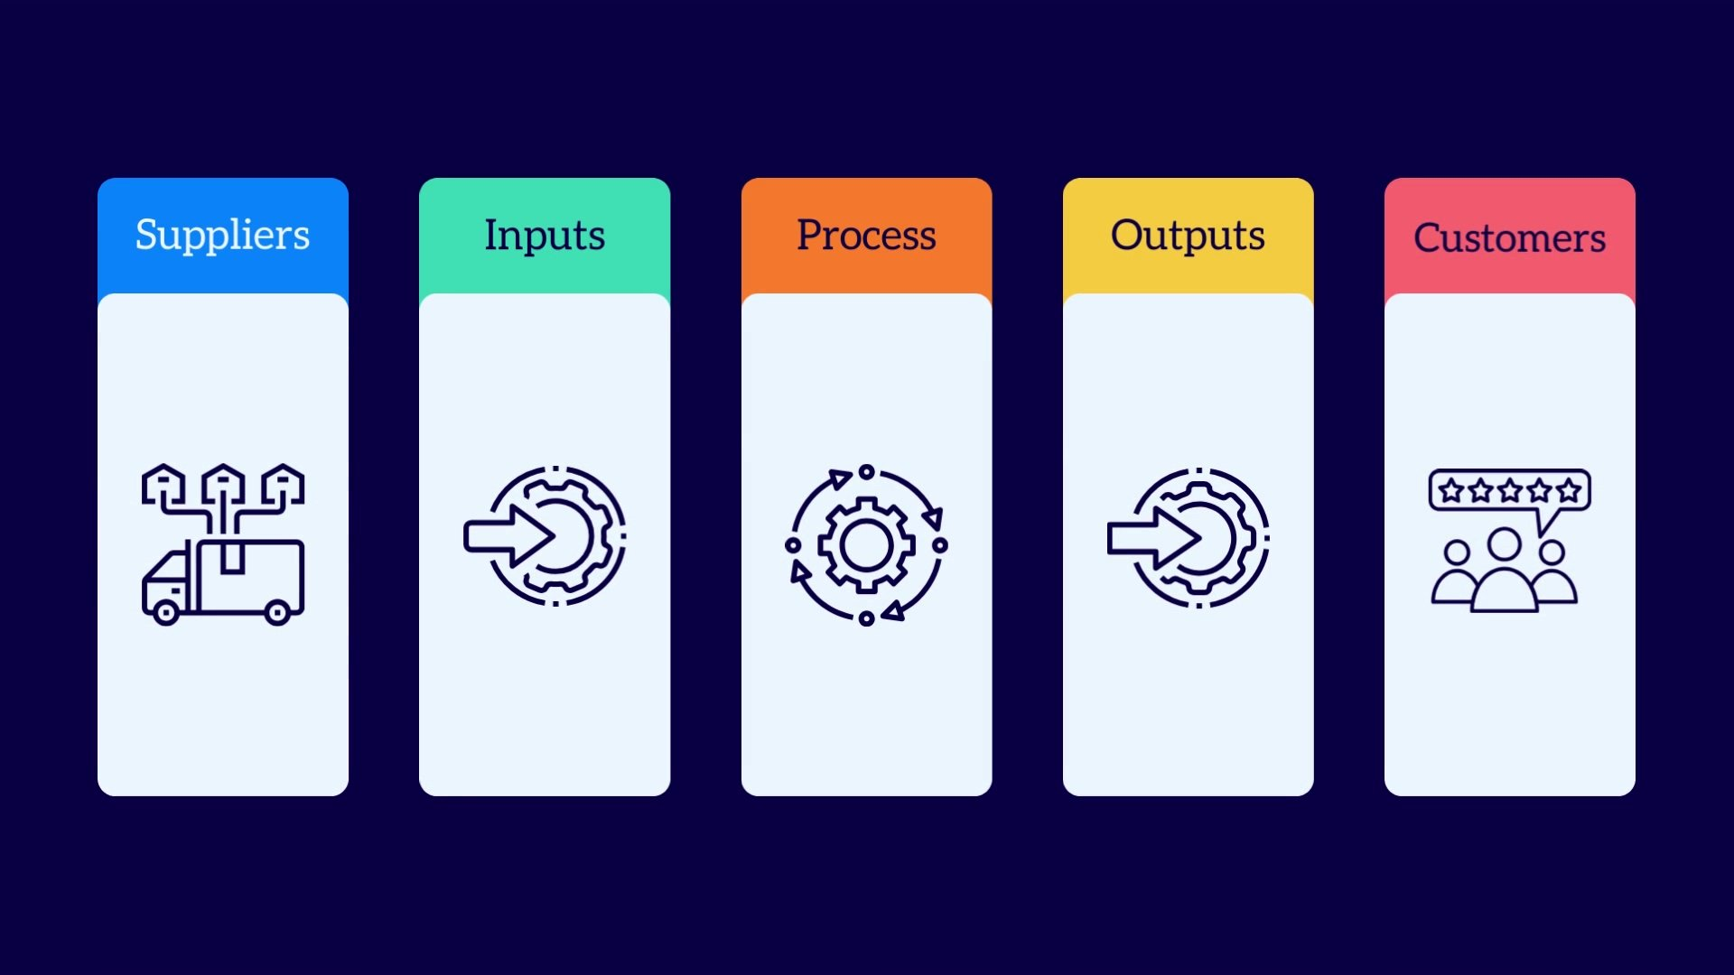
What is SIPOC?
SIPOC stands for Suppliers, Inputs, Process, Outputs, and Customers—a powerful framework for understanding business processes.
It's a high-level diagram that maps the key elements of any business process, providing a bird's-eye view of how work flows from start to finish.
SIPOC visualizes the transformation journey: how inputs from suppliers become valuable outputs that serve customers, creating a shared understanding across teams.
Notes:
“SIPOC breaks a process into five key elements:
Suppliers – who provides the inputs or resources we need.
Inputs – the materials, information, or data that start the process.
Process – the key steps that transform inputs into results.
Outputs – the products, services, or results created.
Customers – the people or groups who receive and benefit from those outputs.
Together, these give a clear, high-level view of how value flows through a process

Slide 3




Why Use a SIPOC Diagram?
Clear Overview
Team Alignment
Provides a comprehensive snapshot of complex processes at a glance, eliminating confusion and creating shared understanding.
Aligns cross-functional teams on process scope, boundaries, and key stakeholders involved at every stage.
Improvement Opportunities
Identifies bottlenecks, gaps, and optimization opportunities before investing in detailed analysis or implementation.

Slide 4
The Five SIPOC Components Explained
01
02
03
Suppliers
Inputs
Process
The sources that provide inputs to your process. These can be people, teams, departments, external vendors, or automated systems that supply necessary resources.
The materials, data, information, or resources required for the process to function. Inputs are what suppliers provide and what the process consumes or transforms.
The high-level steps that transform inputs into outputs. Typically described in 4-7 major stages rather than detailed sub-tasks, keeping the focus strategic.
04
05
Outputs
Customers
The products, services, information, or deliverables produced by the process. These are the tangible results that create value for the next stage or end user.
The recipients or users of the outputs. They can be internal stakeholders, external clients, or subsequent processes that depend on your deliverables.

Slide 5
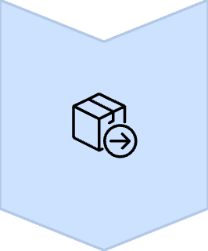




SIPOC in Action: Coffee Shop Example
Suppliers
Coffee bean growers, roasters, equipment manufacturers, dairy suppliers
Inputs
Coffee beans, water, milk, syrups, cups, espresso machines, grinders
Process
Grind beans → Brew espresso → Steam milk → Assemble drink → Serve customer
Outputs
Coffee drinks, pastries, receipts, customer experience
Customers
Walk-in customers, office workers, students seeking breakfast and caffeine

Slide 6
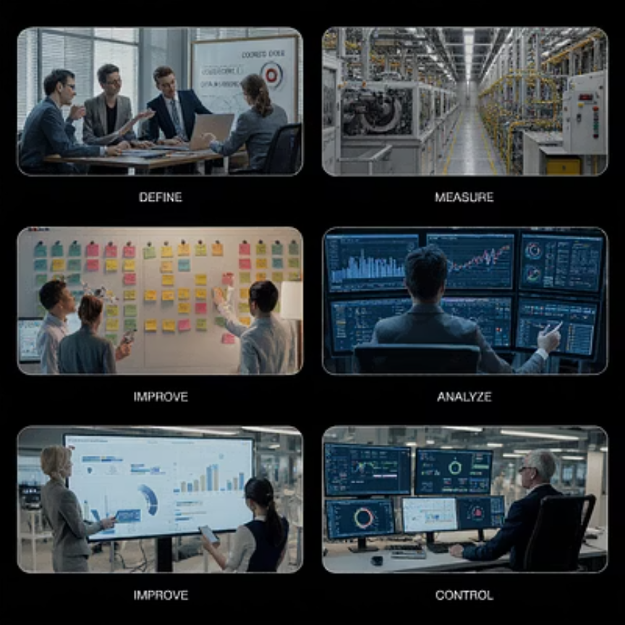
SIPOC and Six Sigma DMAIC Methodology
SIPOC is a cornerstone tool in the Define phase of the DMAIC (Define, Measure, Analyze, Improve, Control) methodology used in Six Sigma projects.
During the Define phase, SIPOC diagrams help teams:
Clarify project scope and boundaries
Identify customer requirements and expectations
Establish baseline understanding of current state
Set the foundation for subsequent measurement and analysis phases
Without a solid SIPOC, improvement initiatives often lack focus and fail to address root causes effectively.

Slide 7





Benefits of SIPOC Diagrams
Enhanced Communication
Creates a simple visual map that bridges communication gaps between technical and non-technical stakeholders, ensuring everyone speaks the same process language.
Clear Boundaries
Defines process start and end points explicitly, preventing scope creep and ensuring teams focus on what matters most within defined parameters.
Early Risk Detection
Identifies bottlenecks, redundancies, missing inputs, and potential failure points early in the improvement cycle, saving time and resources.
Customer-Centric Focus
Keeps customer needs and value delivery at the forefront, ensuring process improvements translate into tangible benefits for end users.

Slide 8
Challenges and Best Practices
Managing Complexity
Keeping Current
Highly complex processes may overwhelm a single SIPOC. Best practice: Break large processes into smaller, manageable sub-process SIPOCs that connect at defined handoff points.
Processes evolve, but diagrams often don't. Best practice: Schedule regular reviews (quarterly or after major changes) to ensure your SIPOC reflects current reality.
Stakeholder Engagement
Digital Collaboration
Resistance to change can derail improvement efforts. Best practice: Involve stakeholders early in SIPOC creation to build buy-in and capture diverse perspectives.
Paper-based SIPOCs limit accessibility and updates. Best practice: Use digital tools like Miro, Lucidchart, or Microsoft Visio for real-time collaboration and version control.

Slide 9
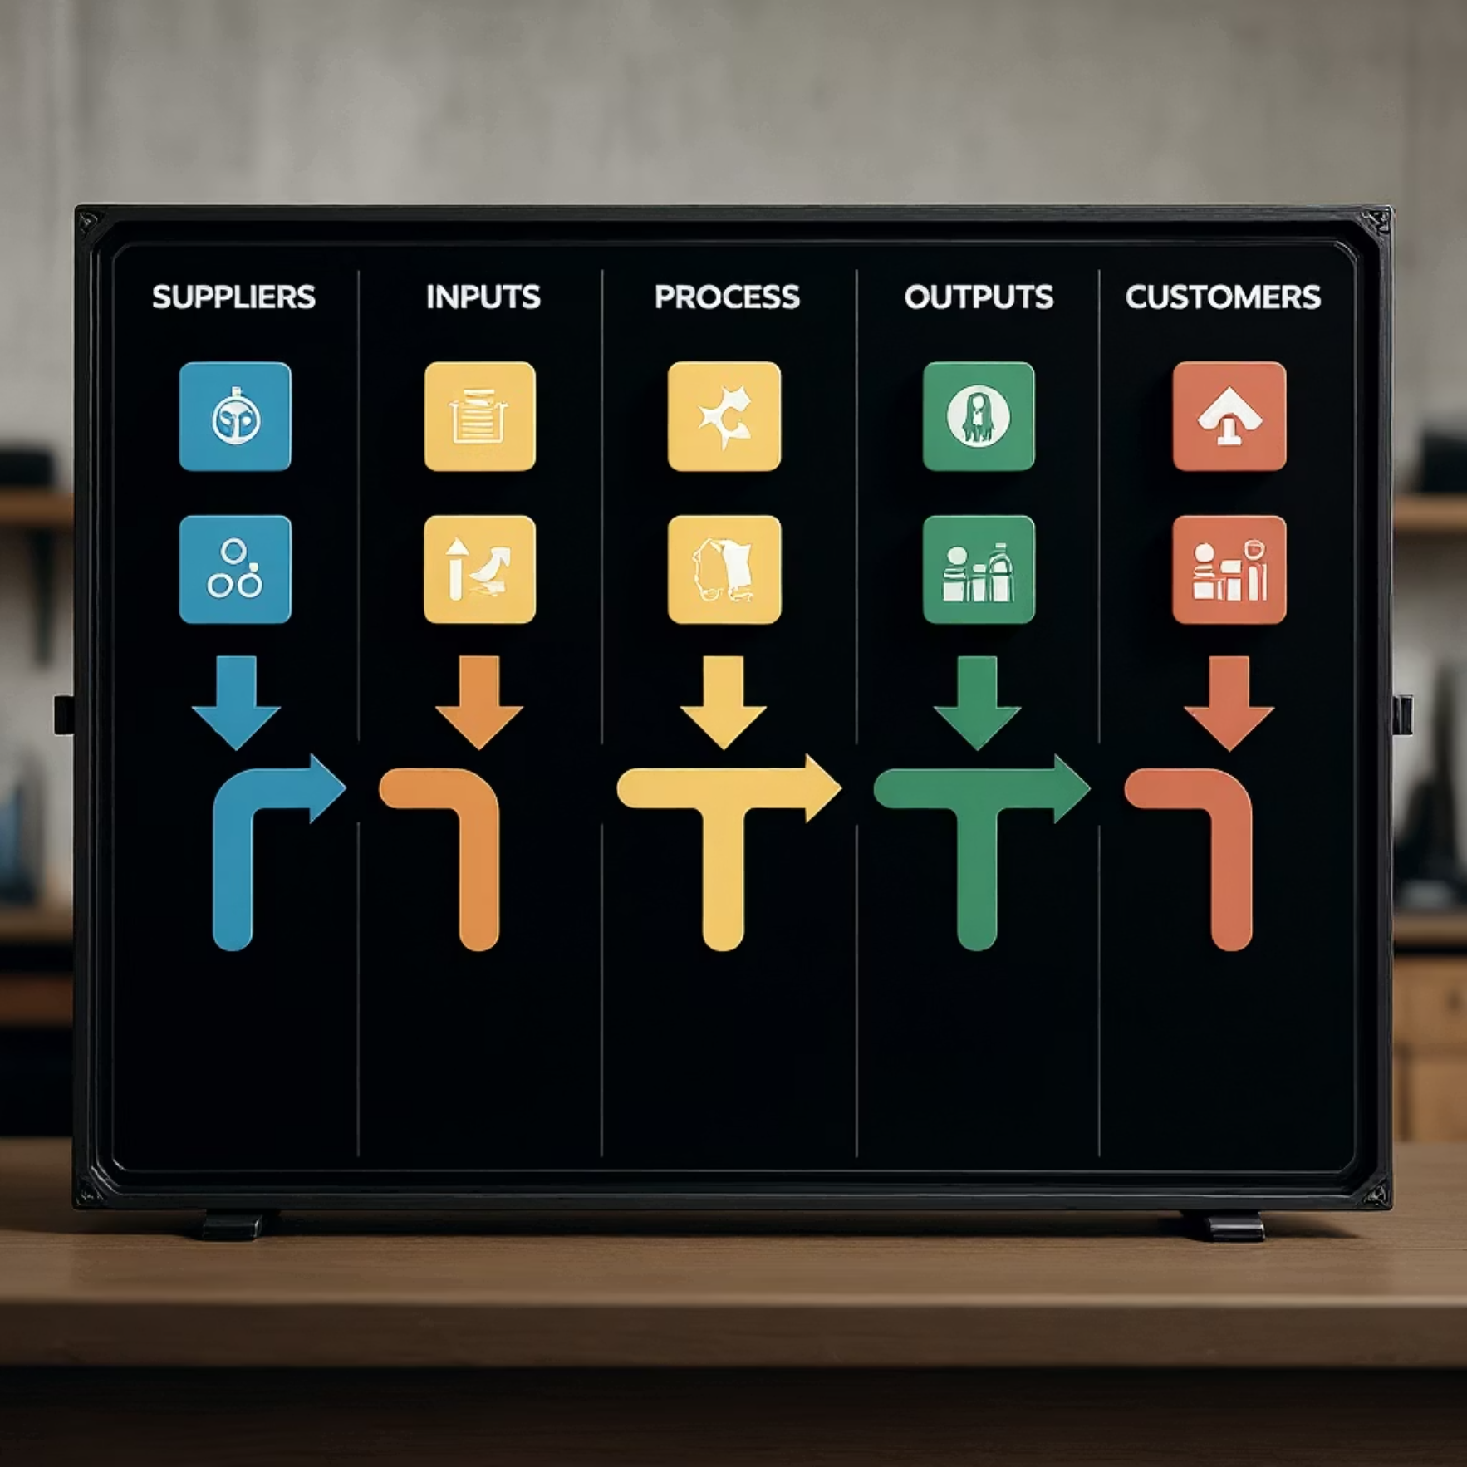

SIPOC vs. Workflow Diagrams
SIPOC Diagram
Workflow Diagram
High-level strategic snapshot
Detailed operational view
Focuses on inputs, outputs, and stakeholders
Shows step-by-step task sequences
Typically 4-7 process steps
Includes decision points and dependencies
Ideal for initial scoping and alignment
Used for detailed execution and training
Answers "what" and "who"
Answers "how" and "when"
Use SIPOC for strategic understanding and project initiation, then create detailed workflow diagrams when you need to implement, train, or optimize specific steps.

Slide 10

Conclusion: SIPOC Empowers Smarter Process Improvement
Simple Yet Powerful
A straightforward tool that delivers outsized value by making complex processes understandable and actionable for everyone involved.
Bridges Communication Gaps
Creates common ground between technical experts, business leaders, and frontline teams, fostering collaboration and reducing misunderstandings.
Essential for Success
A critical component of Six Sigma projects and continuous improvement initiatives, proven to increase project success rates significantly.
"Start your SIPOC journey today to unlock unprecedented clarity, efficiency, and stakeholder alignment in your organization."

Slide 11







Creating Your SIPOC: A Step-by-Step Process
Define the Process
Name the process clearly and establish start/end boundaries. Keep the scope manageable—focus on one process at a time.
Map Process Steps
Identify 4-7 high-level steps that transform inputs to outputs. Avoid getting into detailed sub-tasks at this stage.
Identify Outputs
List what the process produces. Be specific about deliverables, including both primary outputs and any by-products.
Determine Customers
Identify who receives the outputs. Consider both internal and external customers, as well as downstream processes.
List Inputs
Document all materials, information, and resources required. Think about what's needed for each process step.
Name Suppliers
Identify who or what provides each input. Include people, systems, vendors, and other processes that supply resources.
Review and Validate
Share with stakeholders to verify accuracy. Refine based on feedback and ensure everyone agrees on the current state.

Slide 12





CITSOP: A Customer-First Variant
While SIPOC flows from suppliers to customers, CITSOP reverses the order to emphasize a customer-first perspective in process design.
Customers
Start with who you're serving
Outputs
Define what they need
Process
Design steps to deliver value
Inputs
Determine required resources
Suppliers
Identify who provides inputs
Why use CITSOP? This variant encourages teams to think backwards from customer requirements, ensuring every process element directly supports customer value delivery. It's particularly effective in service design, product development, and customer experience improvement initiatives where maintaining relentless focus on the end user drives better outcomes.

